Slide 1
Does The Median Income
Affect Prison Population or Violent Crimes?
Regina Ryan
Kenny Miyasato

Slide 2
Null Hypothesis
Prison Population Is Not Affected By Median Income
Violent Crime Is Not Affected By Median Income

Slide 3
Data Gathering
CSV File
API Call
CSV File
data.ny.gov
Index Crimes by County and Agency: Beginning 1990
api.census.gov
American Community Survey 1-Year Data (2011-2018)
bjs.gov
Prison Population By State For Years (1978-2016)

Slide 4
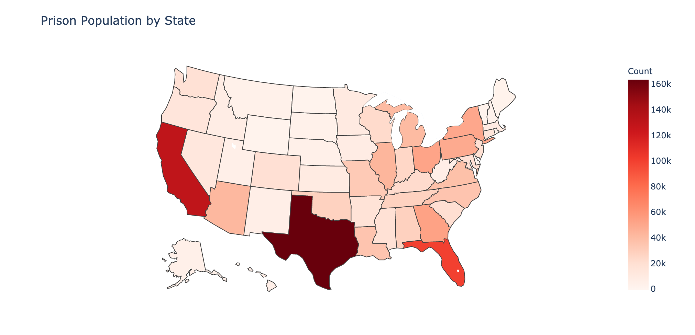

Slide 5
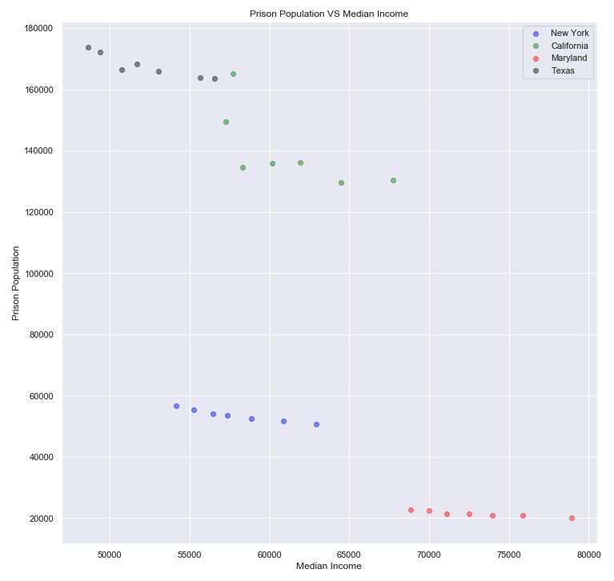

#1
Null Hypothesis
Prison Population Is Not Affected by Median Income
We Reject The Null Hypothesis

Slide 6
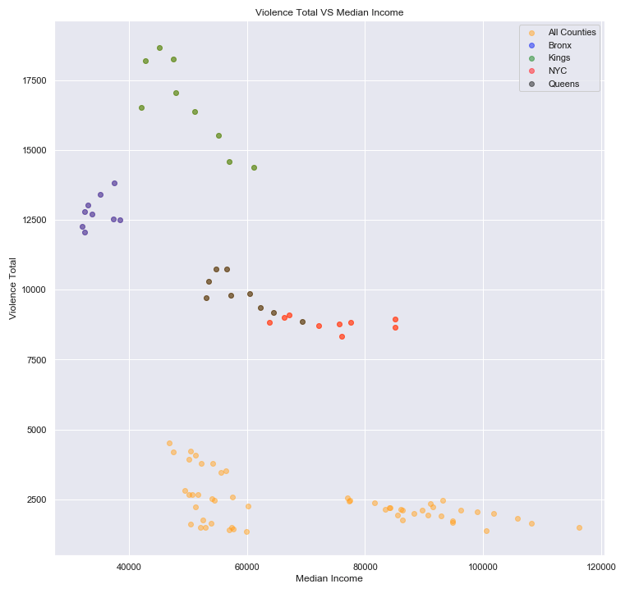

#2
Null Hypothesis
Violent Crime Is Not Affected By Median Income
We Reject The Null Hypothesis

Slide 7
Conclusion
From the data we gathered, we are able to conclude that there is a high probability that both the incarceration rates and level of crimes in the community are affected by the median income

Slide 8
Next Steps:
In the future we would like to further explore the relationship between income, crime, and incarceration rates:
A more granular analysis of the types of crimes committed by county across the US
Explore whether different ethnic communities are affected differently
Include all adult and juvenile correctional populations

